Slide 1

Operator Overloading

Slide 2
Before Operator Overloading
Lets see what does Rule of 3 means
Destructor: Cleans up the resources (e.g., releasing memory) when an object goes out of scope.
Copy Constructor: Defines how an object is copied when passed by value or initialized from another object.
Copy Assignment Operator: Defines how an object assigns data from another object of the same type.
By deafult?
Yes, automatically generated

Slide 3
When to Implement the Rule of Three
If your class manages dynamic memory or resources, implement the Rule of Three:
Write a destructor to clean up resources.
Write a copy constructor to perform a deep copy.
Write a copy assignment operator to handle assignment correctly.

Slide 4
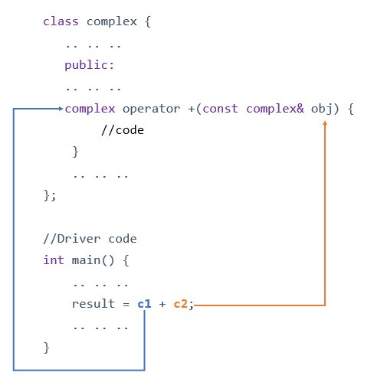

Slide 5
IDE

